Slide 1


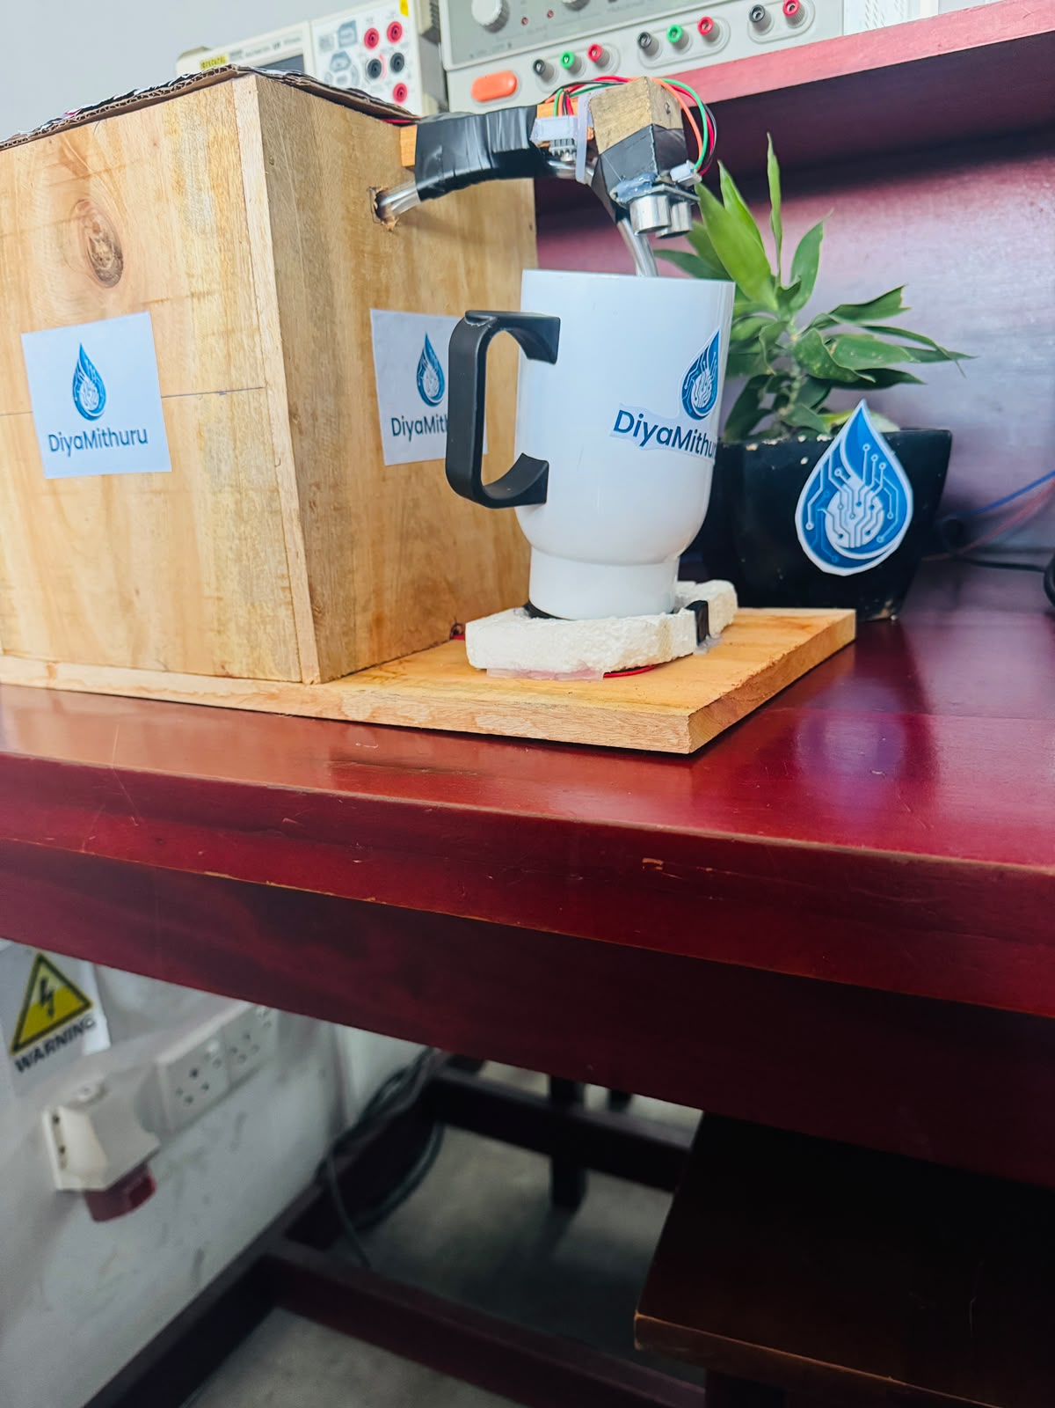
DiyaMithuru
Smart Liquid Filling Assistant
Technology with Compassion
“A safer, easier and more independent way to fill your cup.”
D/ENG/24/0095/ET
M/ENG/24/001/ET
DiyaMithuru prototype
Designed & Developed in Sri Lanka
Notes:
Good evening all .Today we are here to present our newly product DiyaMithuru.It is Smart Liquid Filling Assistant.It helps people fill a cup safely and independently.

Slide 2







A Simple Task Can Be Difficult
“Filling a cup is not easy for everyone.”
Difficulty identifying liquid level
Risk of spills
WHO IS AFFECTED
Visually Impaired Individuals
Elderly People
Safety concerns
Dependence on others
People needing daily assistance
Notes:
Many people find it difficult to fill a cup. Visually impaired and elderly people may spill hot liquids or need help from others.

Slide 3
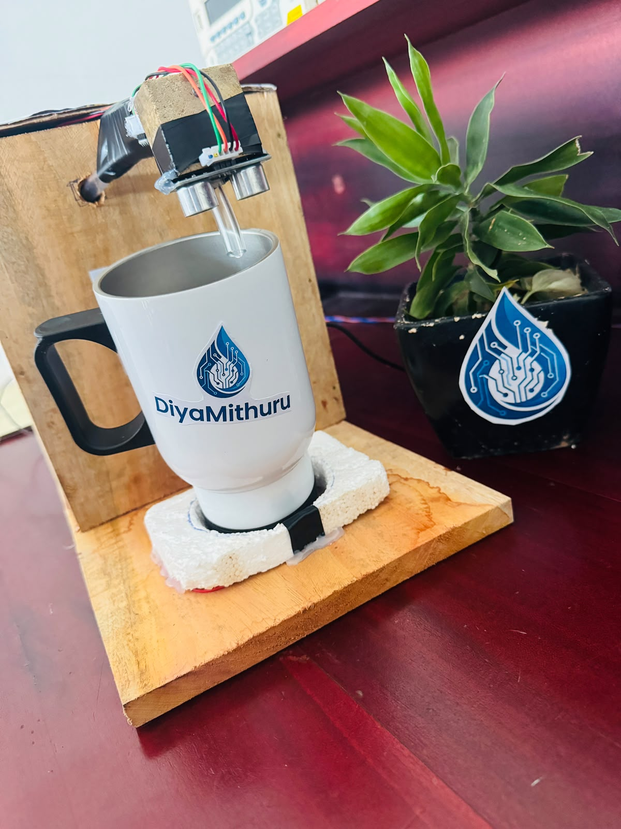



Meet DiyaMithuru
Smart Assistance for Everyday Liquid Filling
Automatic Filling
Temperature Monitoring
Audio Indication
Inclusive Design
“Designed to make everyday liquid filling safer, simpler and more independent.”
PLACE
→
DETECT
→
FILL
→
INDICATE
Notes:
DiyaMithuru detects the cup, fills it automatically, checks the temperature, and gives an audio indication. It makes filling safer and easier.

Slide 4




Designed for Real Daily Needs
PRIMARY USER
Visually Impaired Individuals
SECONDARY USERS
Elderly People
Children & Caregivers
Recovery / Patient Support
General Home Users
Notes:
It is mainly designed for visually impaired people. It can also help elderly people, caregivers, patients, and families.

Slide 5
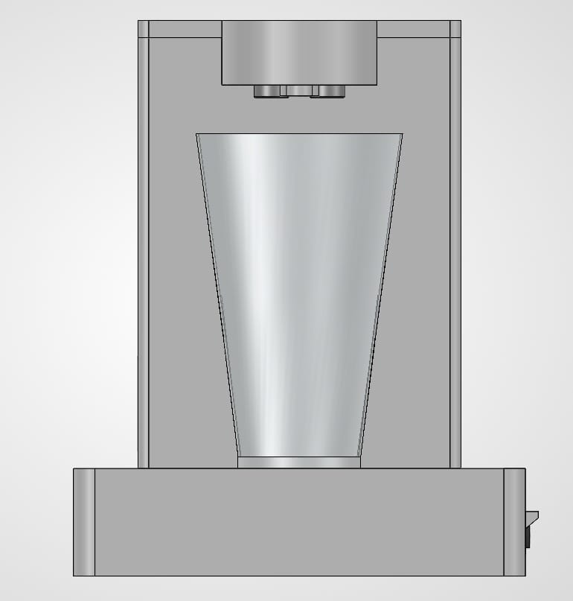




How DiyaMithuru Works
ESP32 Controller
Ultrasonic Sensor
Temperature Sensor
Relay Module
DC Water Pump
12 V Power Supply
1
›
2
›
3
›
4
›
5
›
6
Place the cup
Cup is detected
ESP32 processes the input
Pump dispenses the liquid
Temperature is monitored
Audio indication informs the user
Notes:
The user places a cup. The system detects it, fills the liquid, monitors the temperature, and gives an audio notification when finished.

Slide 6





More Than Just a Product
GREATER INDEPENDENCE
IMPROVED SAFETY
MORE CONFIDENCE
EASIER DAILY LIVING
Supporting Inclusive Technology in Sri Lanka
Technology with Compassion.
Visually impaired user
Elderly user
Family / caregiver
Notes:
IMPACT - 20s. Independence, safety, confidence, easier daily living. Close on Technology with Compassion.

Slide 7
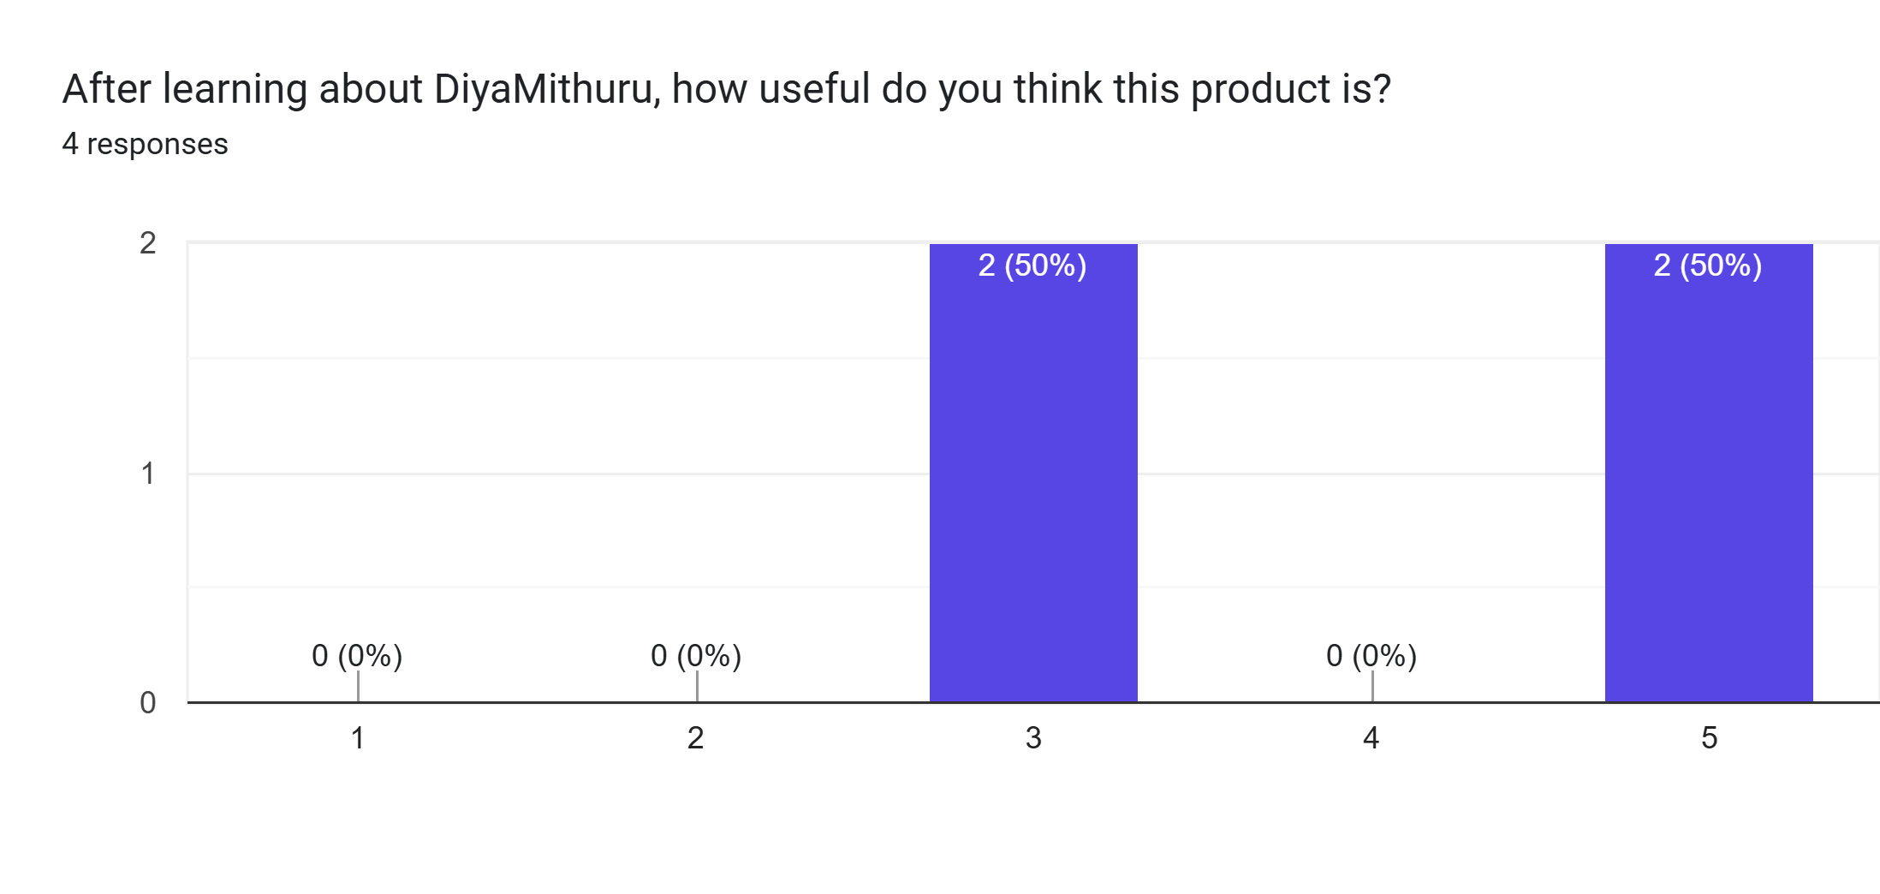
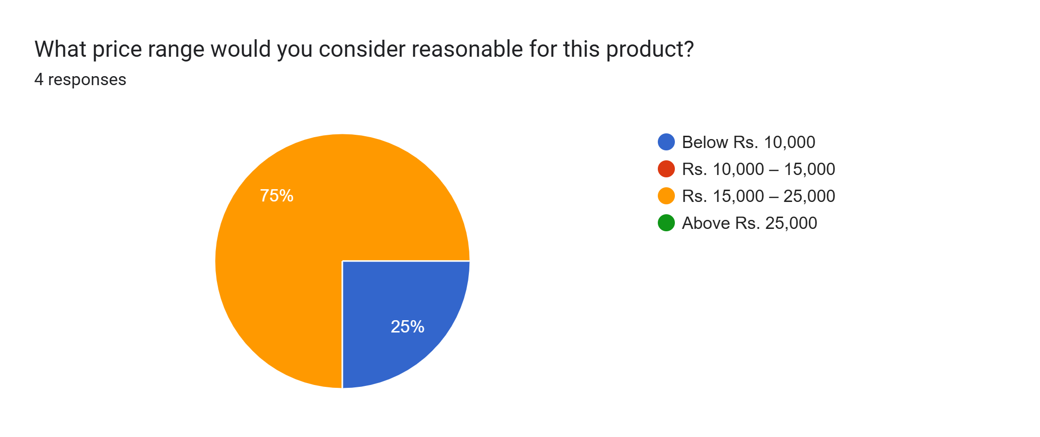





From User Need to Real Product
User Feedback
[INSERT REAL CUSTOMER FEEDBACK]
Google Form Survey
Prototype Testing
Customer Requirement Analysis
PRODUCT-MARKET FIT
Price Validation
LOCALLY DEVELOPED
AFFORDABLE
USER-CENTERED
INCLUSIVE
SIMPLE TO USE
Link - https://docs.google.com/forms/d/1FdYKrwL7_DrpVTMPInImFrXas6RZh5WQtF1M-O45piI/edit
Notes:
We collected user feedback, tested the prototype, and analyzed customer needs. The results show that DiyaMithuru is useful and affordable.

Slide 8



Affordable Assistive Technology
STANDARD PRICE
INSTALLMENT PLAN
LKR 15,000
LKR 5,000 / month
for 3 months · 0% Interest
PROMOTIONAL OFFER: 5% DISCOUNT
SCAN
1-Year Hardware Warranty
Free Islandwide Delivery
PROMOTIONAL PRICE
LKR 14,250
Personal Onboarding
Wall Power Adapter & Accessories
Notes:
The price is LKR 15,000, with a promotional price of LKR 14,250. We also offer installments, a warranty, and free delivery.

Slide 9
FUTURE DEVELOPMENT
Smart Connectivity
Using AI
Improved Audio Guidance
in Tri Basha
IoT Integration using Camera
Notes:
FUTURE - 5s. Roadmap only. Future development items are not current features.

Slide 10

Thank You !
Technology with Compassion
“For a More Inclusive Tomorrow”
Designed & Developed in Sri Lanka
Scan to know more
Notes:
Thank you for listening. DiyaMithuru is Technology with Compassion, created for a more inclusive tomorrow.

